Slide 1
Wordle
The Ballin Marvins

Slide 2

Agenda
Team Information
Project Information
Past Work Summary
Next Checkpoint plan

Slide 3
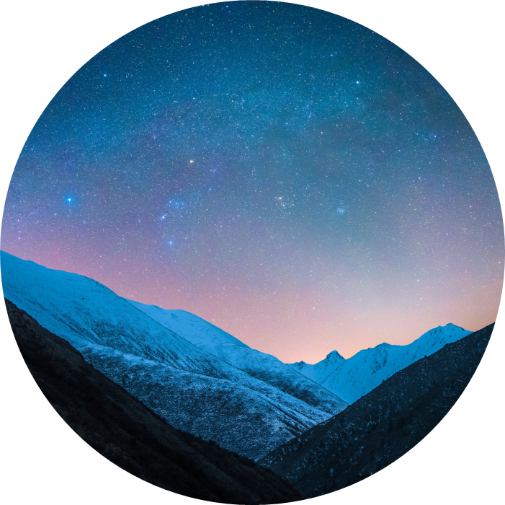
Team Introduction
Team OS systems
Windows
Mac OS

Slide 4
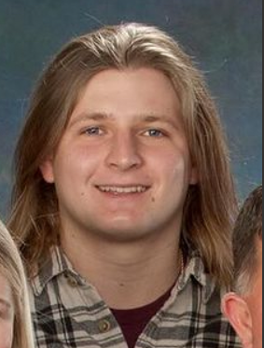
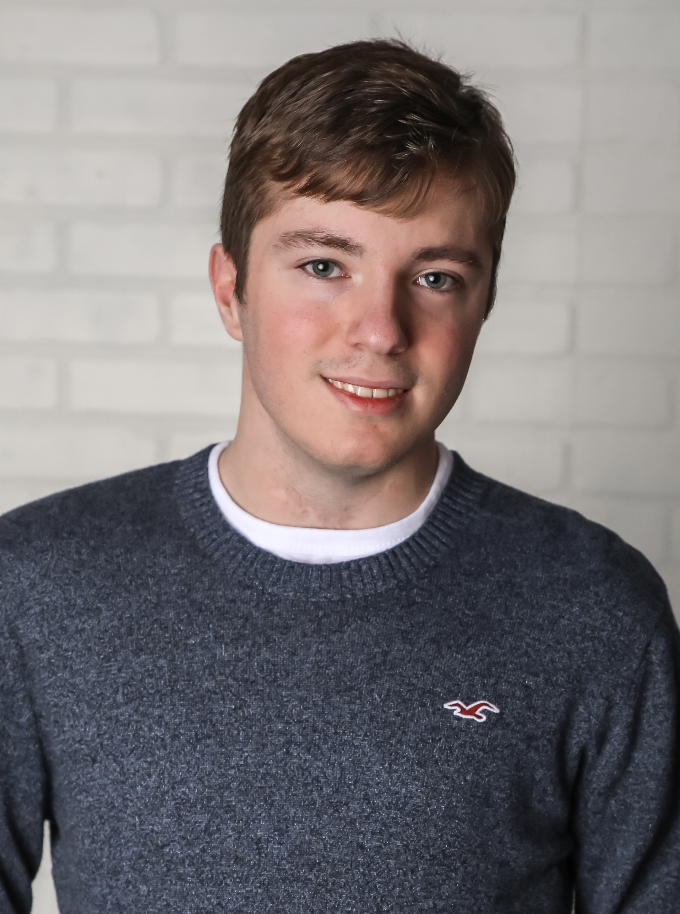
Team
Arthur Ward
Design/implementation
Adam Rajkotwala Design/implementation
Daniel Grimes Implementation/testing
Kofi Asante Testing/quality control
Cameron Adler
Testing/quality control

Slide 5

Weekly Team Meeting time
Thursdays at 2:20pm

Slide 6
Project Information
About Wordle

Slide 7
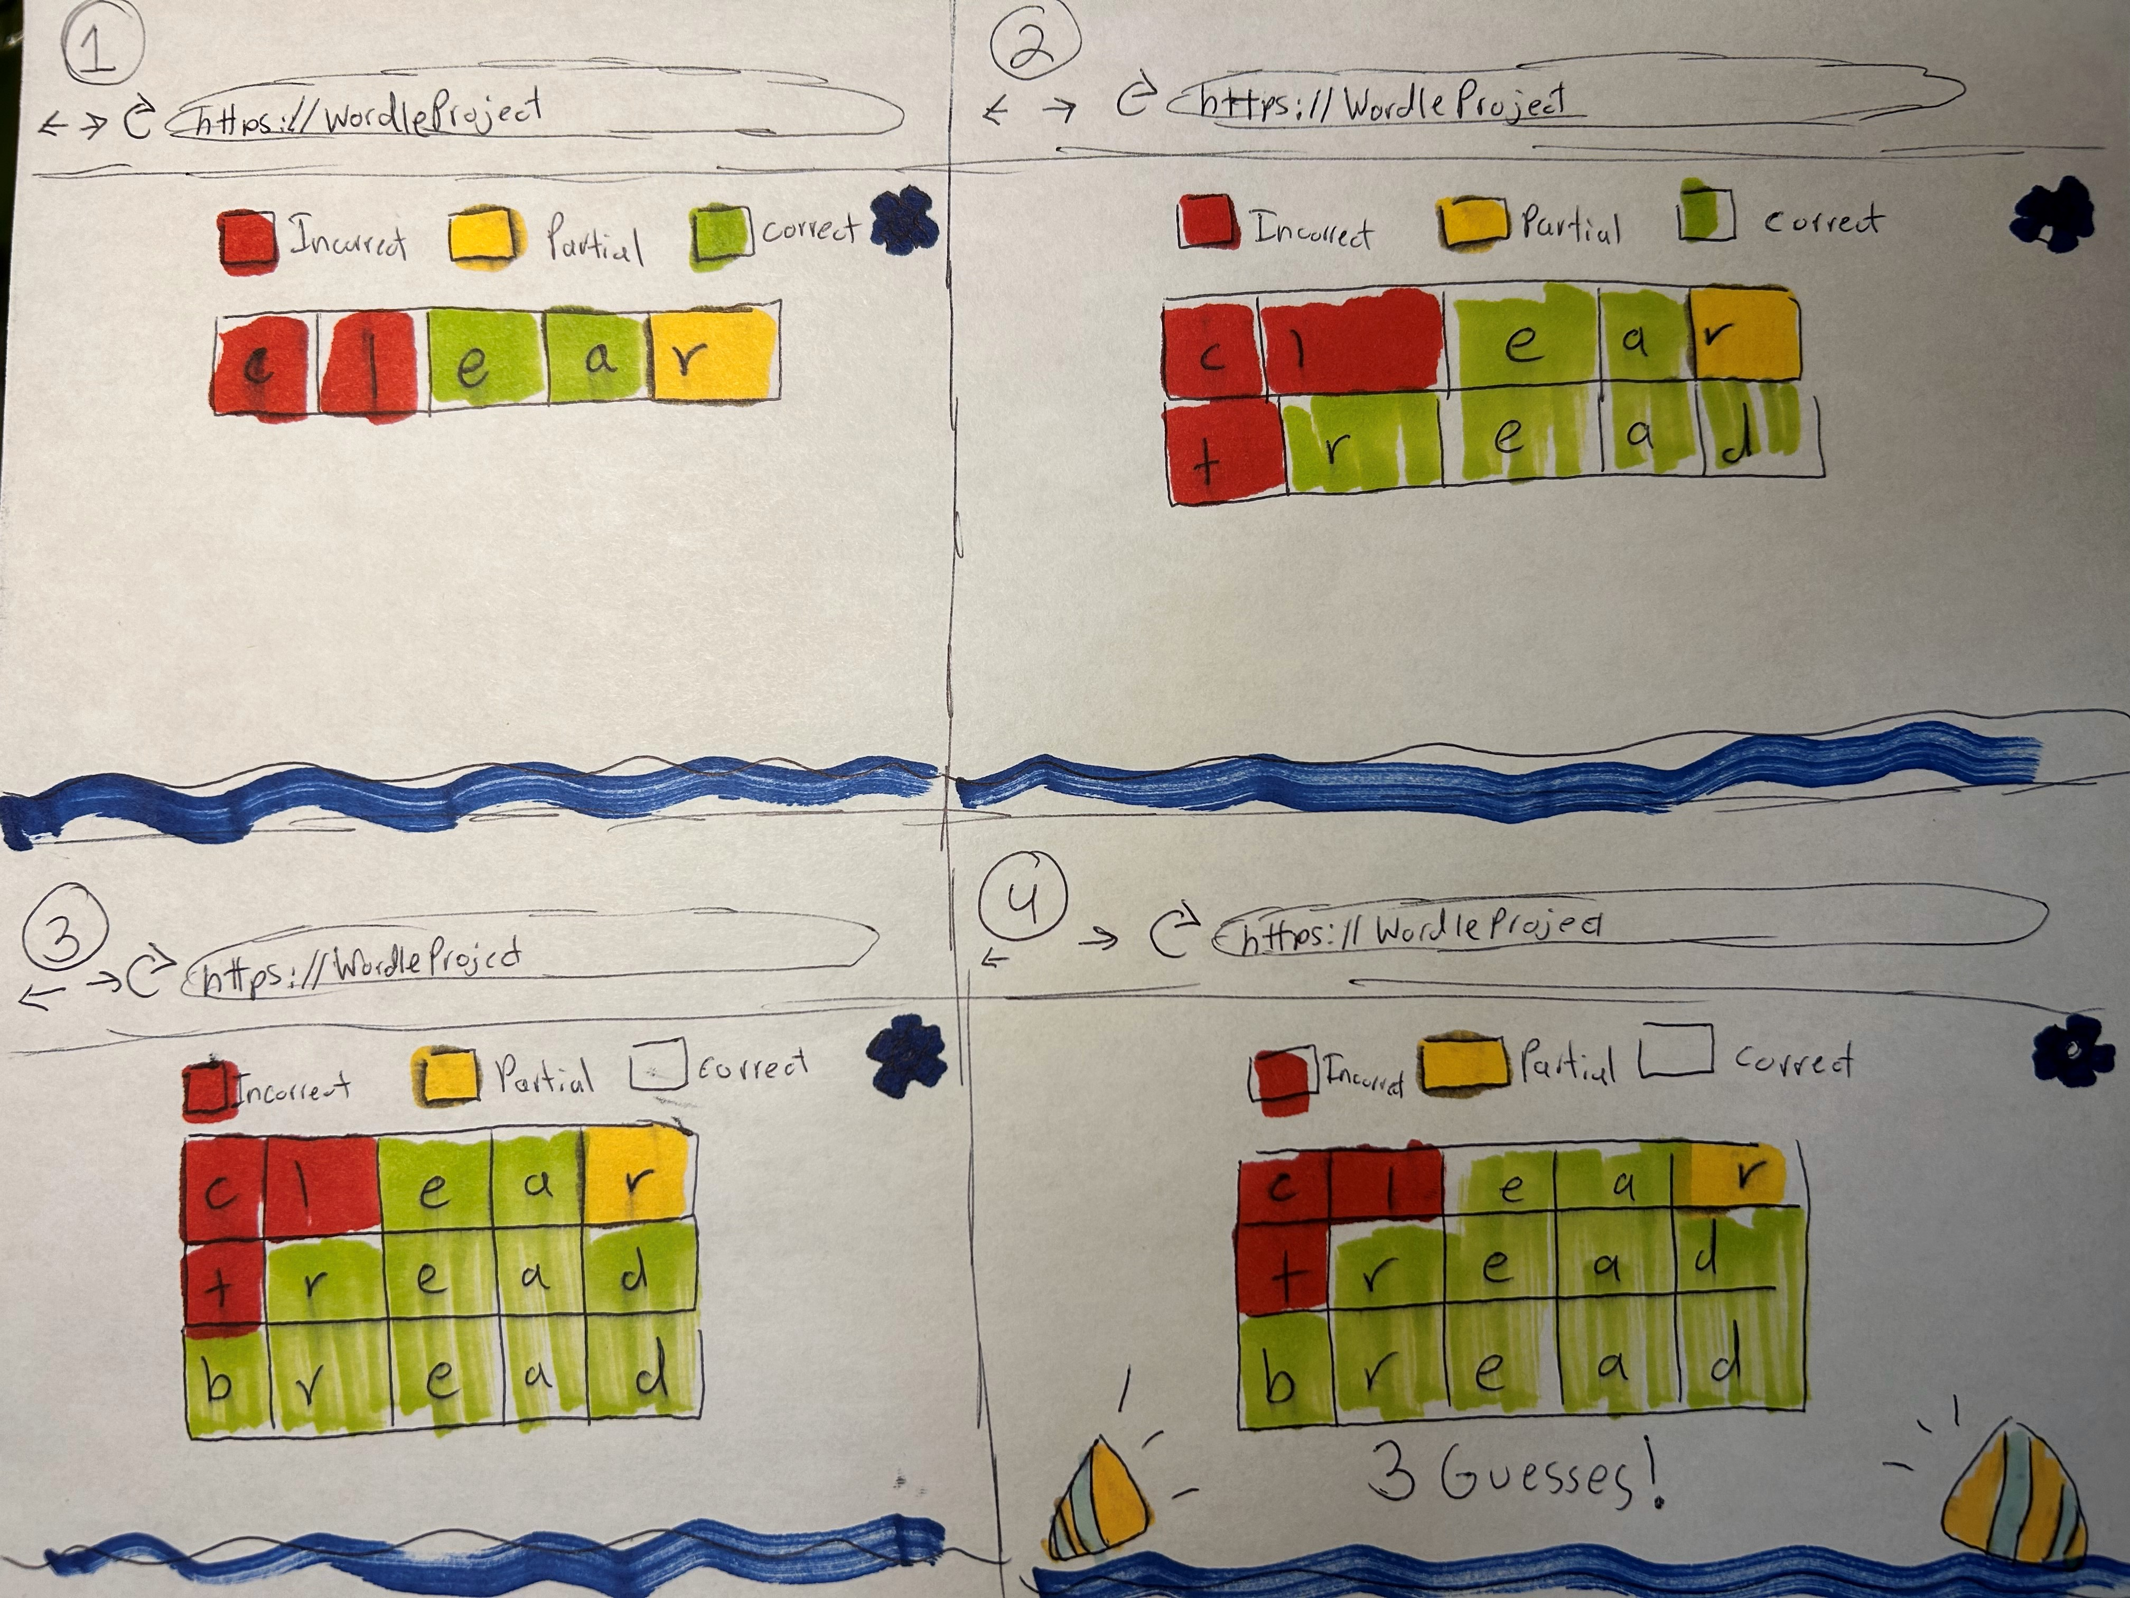
Project Description
About
GUI mockup
The project is to create wordle using python and having our own twist on it
Our goal would be to have a running version of wordle in a browser and then being able to use ai along with it

Slide 8

Tool Chain/Technology
Python (language)
PyGame(GUI implementation)
VS Code (IDE)
Amazon Web Services (Web browser)
GitHub (file management)

Slide 9
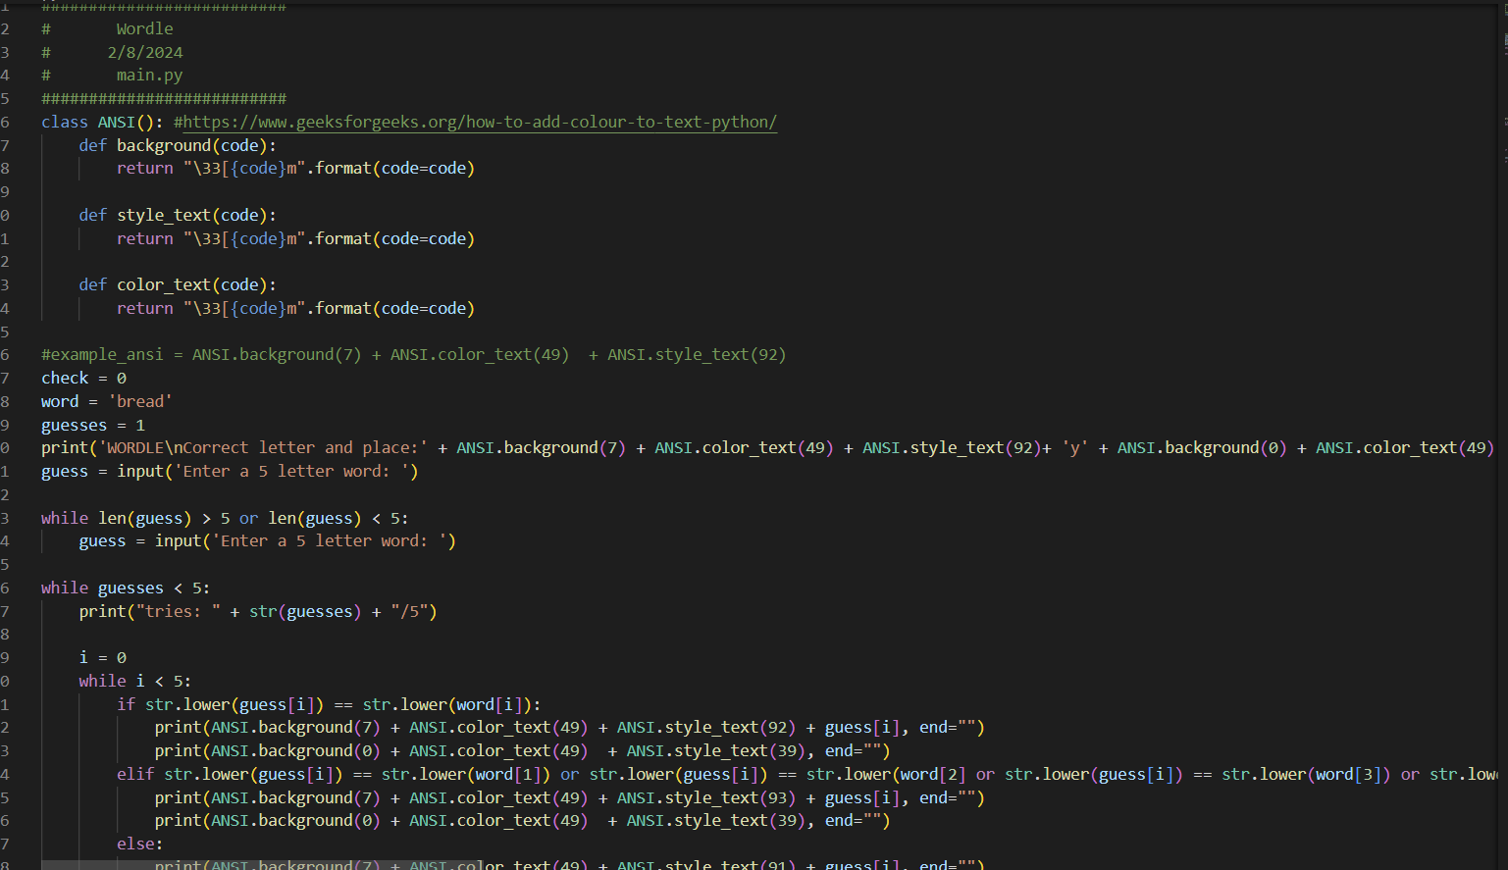
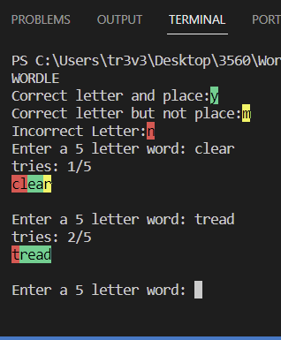
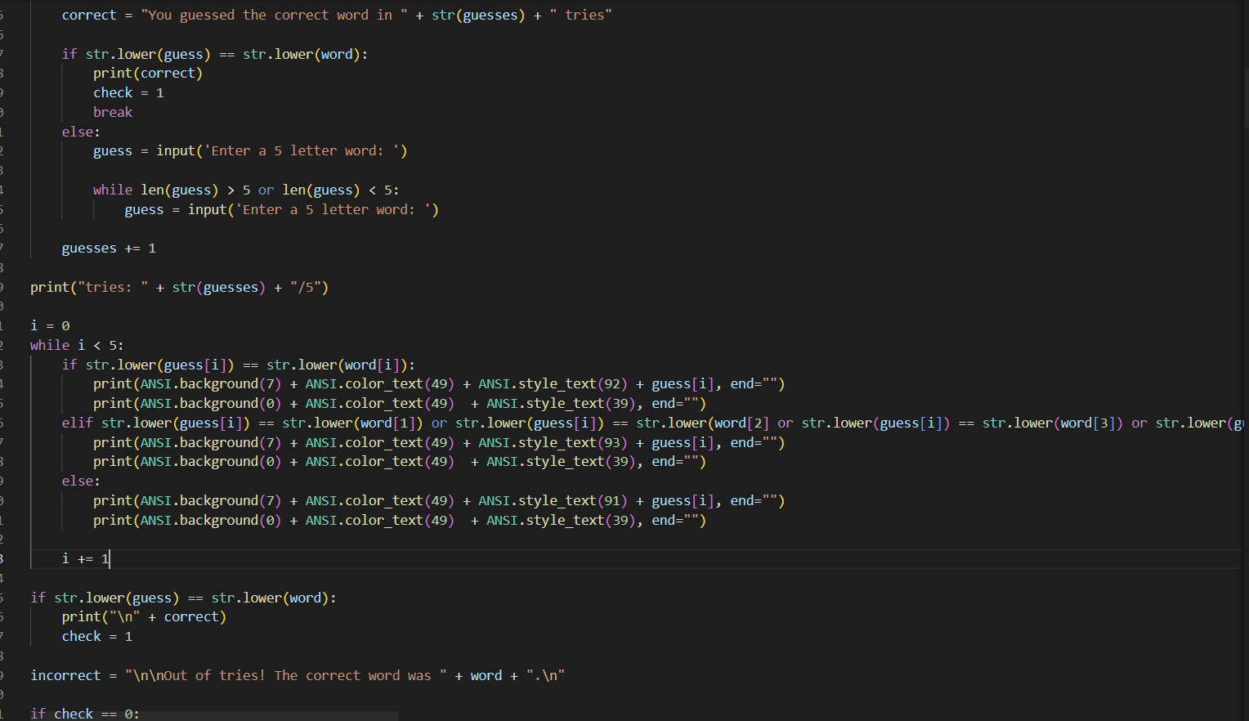
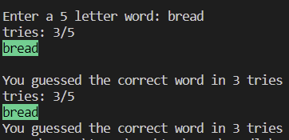
Description Continued
Initial Code Base
Tool Chain
Python
Git
python shell to run in a chrome tab

Slide 10



Past Work Summary
Arthur – worked on design and started on implementation and will continue to work on implementing the project onto python with the group
Adam – discussed design of codebase, refreshed memory of python, began researching what tools to use
Kofi – worked on designing the project and what tools we would use to do so
Danny – Helped work on the design process, will continue work on the backend design proccess/GUI.
Cameron – Brainstormed ideas for how to implement the project
Potential Roadblocks include learning Python, adding our own twist, getting the project to work in chrome, and polishing the project

Slide 11
Next Task
Make a working prototype of Wordle in Python on a chrome tab

Slide 12




Thank you
To be continued ...

Slide 13
Grading Items
Checkpoint #1

Slide 14
Meeting attendance
2/1/2024 All members attended
2/9/2024 All members attended

Slide 15
Summary
Created a hello world style program that runs similar to wordle, only in python in the terminal. Currently only one word is able to be guessed and program outputs colors when letters are in the correct places.

Slide 16
Arthur Ward Contributions-
-Started to work on a rough hello world version of wordle in python. This rough version included a word to guess, input by the user through the terminal, and color coordinated spots to tell the user if a letter was in the correct place or not
-I have zero background knowledge in Python so I learned a bit while coding the base code for the project. I hope to become more familiar with Python as we get further into the project

Slide 17
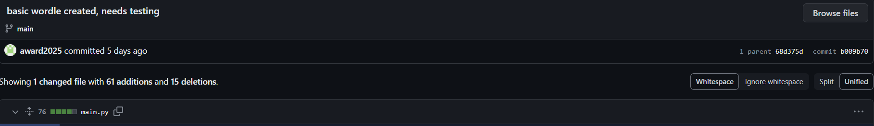
Arthur Ward (github:award2025) https://github.com/OU-CS3560/s24-wordle-fibble-3
Commit #4

Slide 18
Adam Rajkotwala Contributions-
-Conducted research regarding what tools we should use for GUI implementation, connection to a web browser, and other useful python libraries.
-My first coding class was in Python almost two years ago. In addition to trying to refresh my memory of the language's syntax and features, I've been there to help my teammates learn along the way.

Slide 19
Cameron Adler Contributions-
-Looked into implementations of Wordle already done in Python
-Looked into Rich library for Python
-Brainstormed ideas for our implementation of Wordle
-I have some limited Python experience from taking a class on it a few years ago. I look forward to expanding that experience and becoming more comfortable with using it for an actual deployable application

Slide 20
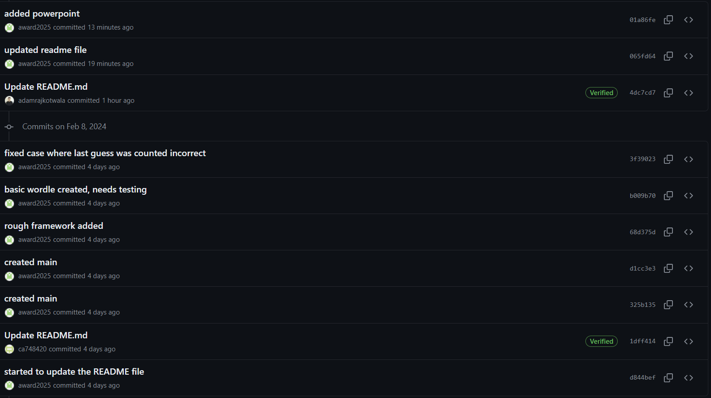
https://github.com/OU-CS3560/s24-wordle-fibble-3/commits/main/ 11 commits in total

Slide 21
Kofi Asante ConTRIBUTIONS
My role has been to help come up with the various designs and design analyses we need to help make this project effective.
Gathering previous knowledge I have in Python I am looking forward to work with my group to ensure that we develop and fun wordle project and even more important generate the best AI solver possible.

Slide 22
CheckPoint 2

Slide 23
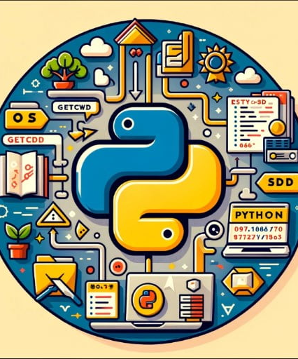
Past Period Work
Arthur Ward – Worked on general foundation UI for Wordle, along with basic functions of the game
Adam Rajkotwala – Implemented draw and delete functions for the given letter typed to display to screen.
Cameron Adler – Added word list and random word selection to pygame version, discovered small bug(s)
Daniel Grimes - tried different GUI systems and designed a PyGame model based off of the code from the initial TK implementation, design of colored squares and letter checking

Slide 24

Next Period Work
Arthur Ward - Polish the look and feel of the game and add any other necessary code to complete the core elements of the game
Adam Rajkotwala – Assist in polishing the look/feel of the game, begin working on AI solver
Cameron Adler – Continue to improve UI and playability, fix any bugs that have been/are discovered
Daniel Grimes - continue to develop UI and add a few small features (game won display and display of all characters to see what has been used), along with work on the web browser implementation
Kofi Asante – worked together with Cameron to generate an appropriate word bank and generated code which ensured every word was correct.

Slide 25
RoadBlocks
Potential upcoming roadblocks include:
-Getting used to all of the commands pygame uses
-Making/creating an AI capable of playing Wordle
-Polishing the project and making it look and play well
-Becoming familiar with and learning how to get the game on a web browser

Slide 26
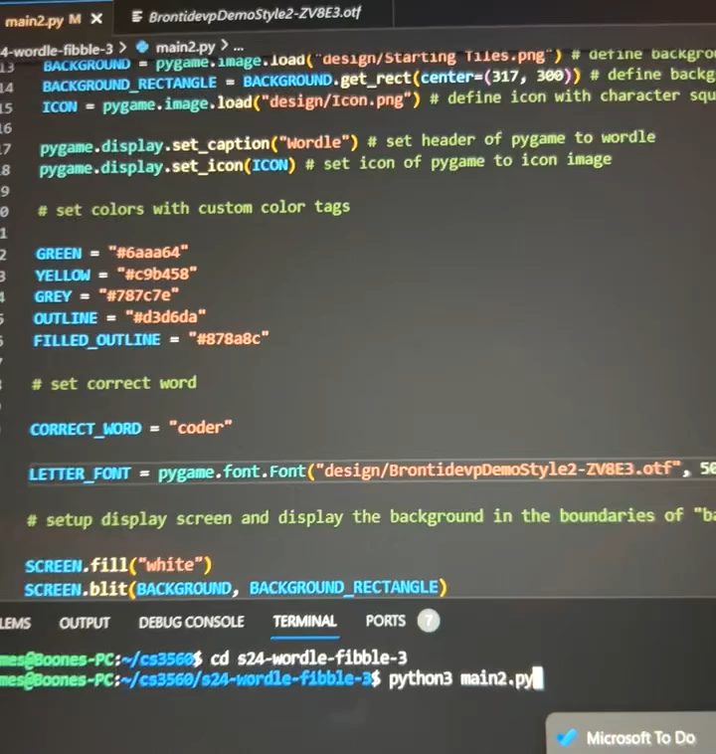
Live Demo

Slide 27
Any Questions?
To be continued ...

Slide 28
Grading Items
CheckPoint #2

Slide 29
Meeting attendance
2/22/2024 – Daniel was not able to make it due to upcoming exams

Slide 30
Arthur Ward Contributions
-Worked on base UI for the Wordle game. Main focus was getting everything center, basic warning boxes setup, 5 tries, and ability to take guesses from user. The basic functionality of the game was created in this time period. Also made contributions through comments and clean looking code.

Slide 31
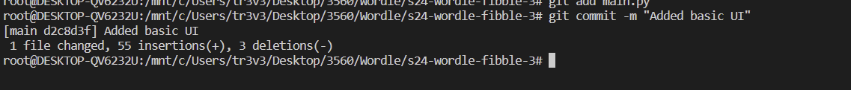
Arthur Ward (github:award2025) https://github.com/OU-CS3560/s24-wordle-fibble-3
Commit # 18

Slide 32
Adam Rajkotwala Contributions-
-Implemented draw and delete functions for the given letter typed to display to screen
-Assisted in research and testing of different gui frameworks
-Made comments

Slide 33
Adam Rajkotwala (github:adamrajkotwala) https://github.com/OU-CS3560/s24-wordle-fibble-3
Commit # 21

Slide 34
Kofi Asante
Changed the configuration in the enter guess function to ensure that the user as entering a word and not something else.

Slide 35
Kofi Asante

Slide 36
Cameron Adler Contributions-
-Implemented word list and random word selection into version that uses pygame
-Discovered two minor bugs (ability to enter another guess after correct guess has been entered, second occurrence of letter in guess being marked as yellow when the only correct occurrence has already been marked as green elsewhere in same guess)

Slide 37
Cameron Adler (github: ca748420) https://github.com/OU-CS3560/s24-wordle-fibble-3
Commit # 26

Slide 38
Daniel Grimes contributions
Branched off into the development of a PyGame GUI, as this allows for more customization and a cleaner setup
Set fonts and colors of the GUI along with getting the correct colors to show behind each letter
Testing and revision of the original implementation that was used
Commits pushed to github repo

Slide 39
CheckPoint 3

Slide 40
Past Period Work
Arthur Ward – fixed a bug where feedback from a guess would result in two letters being highlighted yellow in word when only one should have been
Adam Rajkotwala – Began pyscript implementation so that the game will be playable in a browser. Fixed word list, made sure that it only includes real words.
Kofi Asante – Worked on improving the game logic by adding features suitable to how wordle works.
Daniel Grimes – implementation of the keyboard system at the bottom of the display, small bug fixing, and static analysis fixes
Cameron Adler – Worked on prototype on-screen keyboard and ensured game ran efficiently

Slide 41
Next Period Work
Arthur Ward – Continue to work on general UI + assist in adding any other features necessary to the core game
Adam Rajkotwala – Continue to experiment with different methods of playing the game in a browser and work on getting it hosted live somewhere so that it is playable for everyone.
Kofi Asante – Work on improving the game logic and attempt to make the UI look prettier
Daniel Grimes – begin to work on adding unique features for our project along with development of the AI
Cameron Adler – Research/test different options for AI and make any necessary quality/cosmetic improvements

Slide 42
RoadBlocks
Potential upcoming roadblocks include:
-Making/creating an AI capable of playing Wordle
-Continuing to polish project gameplay and UI
-Becoming familiar with and learning how to get the game on a web browser

Slide 43
Toolkits
Toolkits include:
IDE – Visual Studio Code (platform used to code the entire project in conjunction with Github)
Library – Pygame (tool used to implement functionality of game along with its UI)
Language – Python (easy to read and use language ideal for making Wordle)
File management – Github (allows member of the team to work on code simultaneously from different spaces by being a storage for the entire project. It also allows for easy access to past coding checkpoints)
Web Framework – PyScript (modern tool that allows for friendly communication between python and javascript)

Slide 44
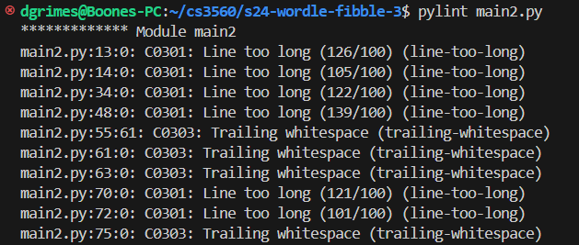
Static Analysis
(Arthur, Kofi, Adam, Cameron, Daniel)
All team members used the same tool for static analysis 1.(Clang). The result ended up being testing and fixing the code on a case by case basis for each error occurrence. The tool shows when an error occurs in the code. Vscode then would show whether or not the intended output was achieved
2.(Pylint) was also used for static analysis. This system can be run from the terminal using pylint <filename>. The pylint output provides error messages that begin with either (C, E, W, F) – respectively for conventional issues, errors, warnings, and fatal errors.

Slide 45
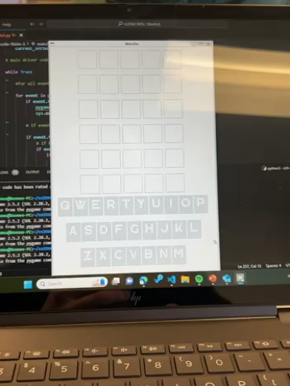
Live Demo
Version 2.0

Slide 46
Any Questions?
To be continued ...

Slide 47
Grading Items
CheckPoint #2

Slide 48
Meeting attendance
2/29/2024 – Everyone
3/7/2024 – Daniel could not make it due to family reasons

Slide 49
Arthur Ward Contributions
- I worked on fixing an error where a guess, say for example, abyss would result in the output of both s being marked as in the word, but only one is present in the correct word to guess. It took a bit longer than expected but a combination of two arrays, a single function, and adding onto the check guess function fixed the error.

Slide 50
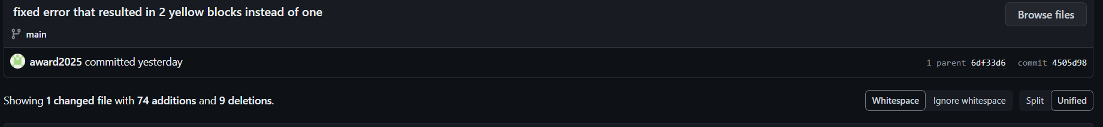
Arthur Ward (github:award2025) https://github.com/OU-CS3560/s24-wordle-fibble-3
Commit # 17

Slide 51
Adam Rajkotwala Contributions-
-I spent a lot of time researching and experimenting with different methods of implementing our python script within a web browser and having it hosted. PyScript captured my interest and has been what I have been learning/attempting to implement, and while I'm close, I just found out about a pygame specific web framework that may be easier to use since we are using pygame.
-I also fixed our word bank, as it was filled with non-existent words.

Slide 52
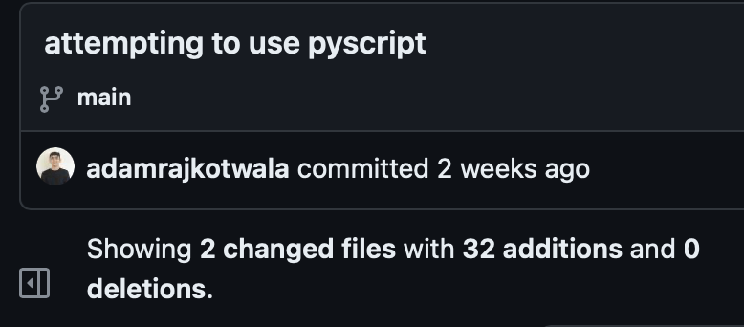
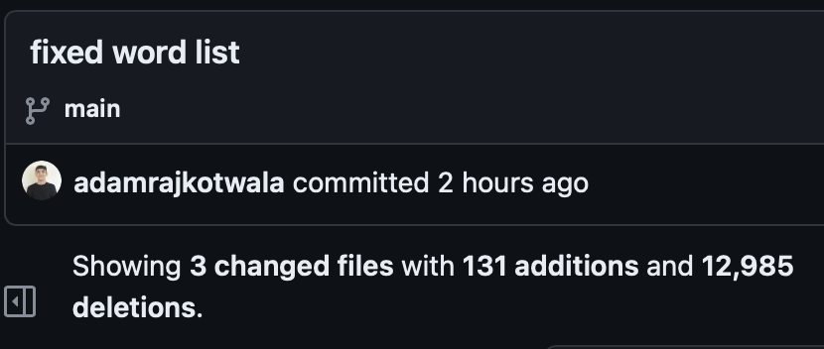
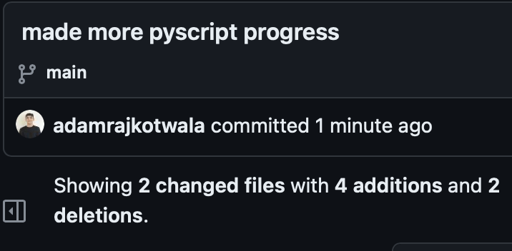
Adam Rajkotwala (github:adamrajkotwala) https://github.com/OU-CS3560/s24-wordle-fibble-3
Commits # 29, 32, 33

Slide 53
Cameron Adler Contributions-
-Worked on creating on-screen keyboard that is functional with Wordle. Was able to get basic keyboard to appear on the screen that works, but didn't get to implementing specific Wordle functionality (keys changing colors as letters are guessed)

Slide 54
Kofi asante contributions
Began work on adding new features that will ultimately lead to an improvement of the game in general.

Slide 55
Daniel Grimes contributions
Worked on development and implementation of the on screen keyboard that will be displayed and the new class “Alphabet” that handles this. I also spent time researching static analysis and specifically pylint. Was able to get correct color on the onscreen keyboard aswell. (main3.py is the version that I have worked on, GITHUB issues would not allow me to push so it was sent to Cameron and he uploaded to Git).

